Slide 1


PowerShell Scripts Classification
By: Talia Seada 211551601 & Dana Zorohov 207817529

Slide 2
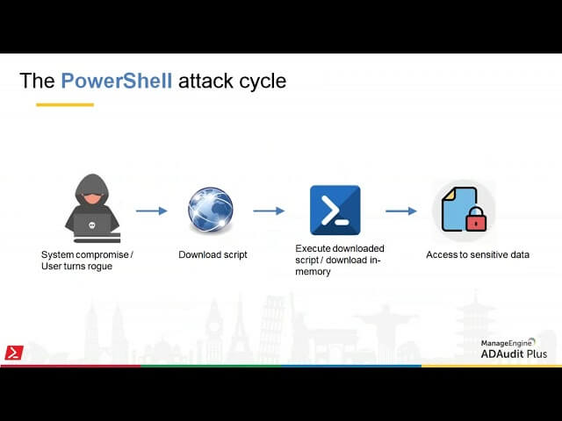
The problem we solved is classification of PowerShell scripts
The Dataset containing benign, malicious and mixed scripts – which are benign scripts with injected malicious scripts to demonstrate real life scenarios.
During the preprocessing of the data, we improved it by removing outliers.

Slide 3
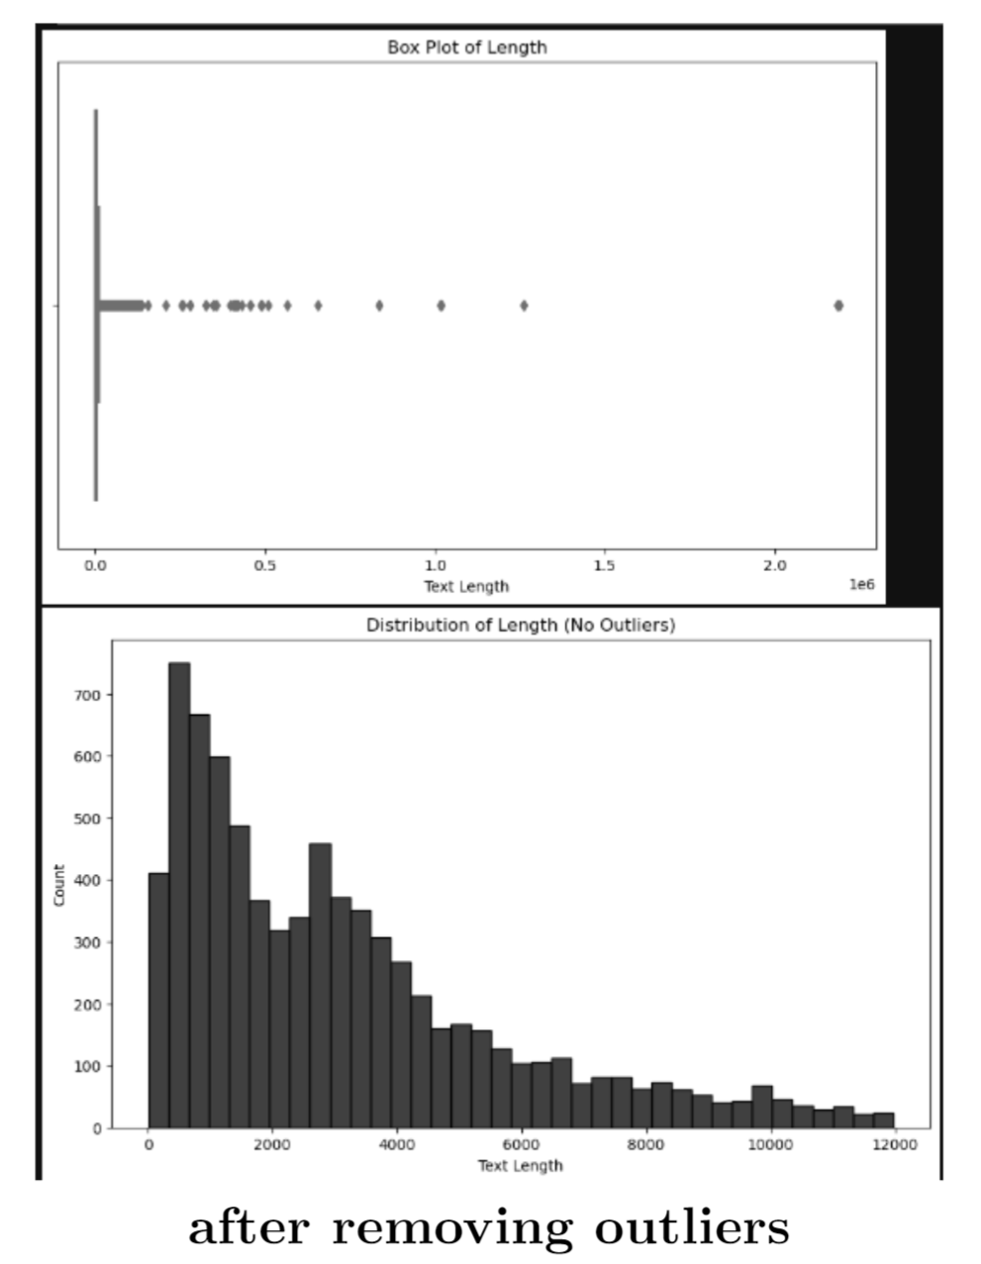
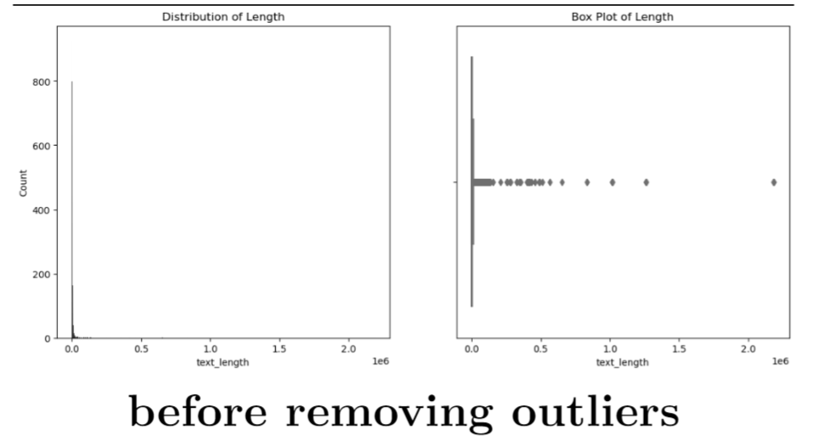

Slide 4

Evaluation
Creation of new column that contains cleaned scripts
TF-IDF features are created using a trigram (3 ngram) approach with a vocabulary size of 10,000
Using SelectKBest to reduce the dimensionality of the feature space by selecting the top 1,000 most informative features
Features extracted from the ’cleaned script’ including Text length, Function count, Numeric literal count, Has error handling, Has obfuscation indicators, Has suspicious words
Features extracted from the original script encompass: Entropy, Punctuation count, Longest string length, String literal count, Has URLs or IPs

Slide 5
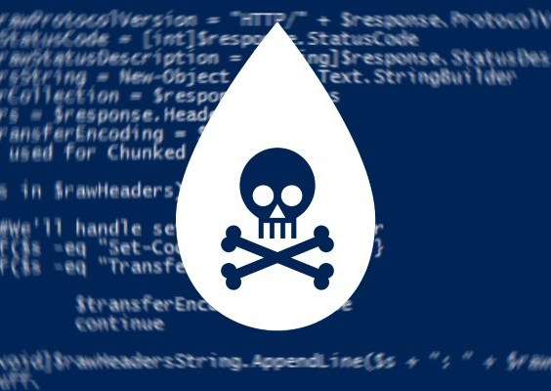
Data Exploration
identifying patterns
anomalous behavior
correlations
Notably, in the mixed model, we observed that 6,213 scripts contained suspicious words, suggesting their presence even within benign scripts.
Additionally, we detected outliers within the dataset. To mitigate their potential impact on model learning, we systematically removed them

Slide 6
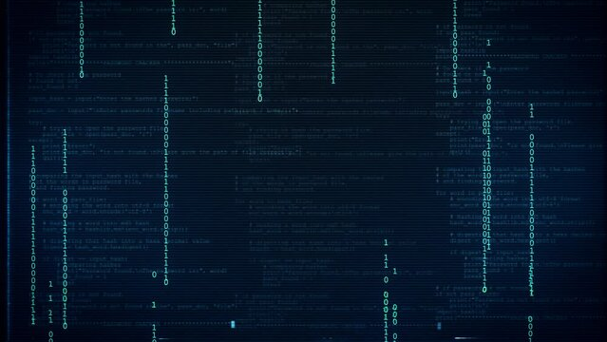
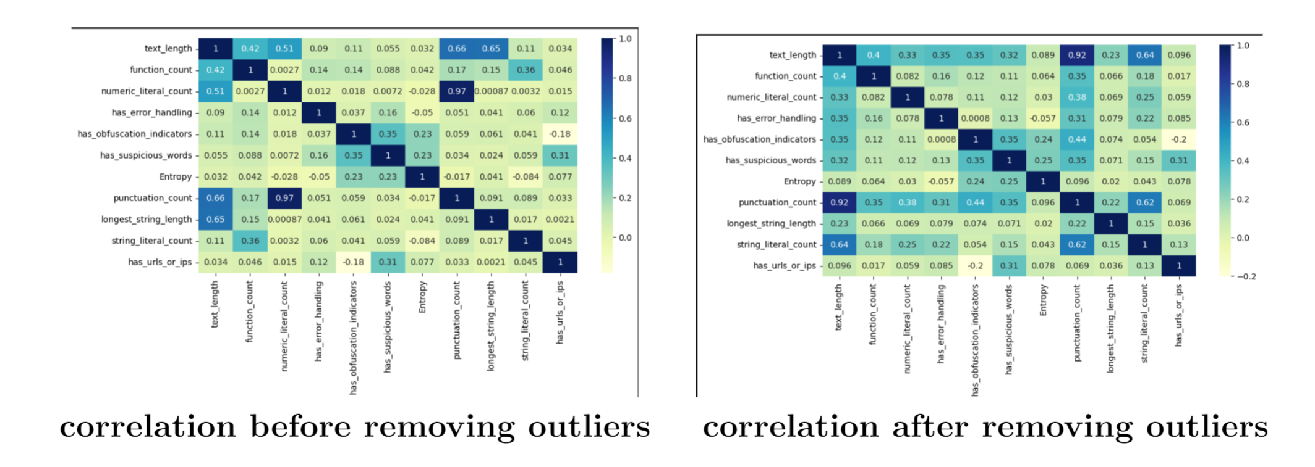
Cross-Correlation
After removing the outliers, we can see more correlation between the features

Slide 7
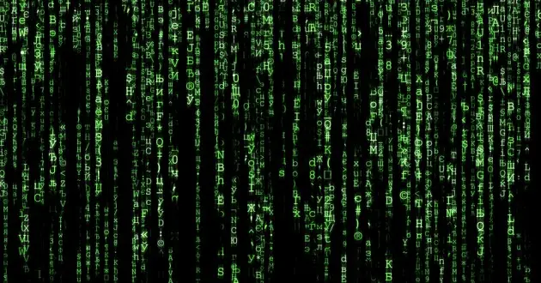
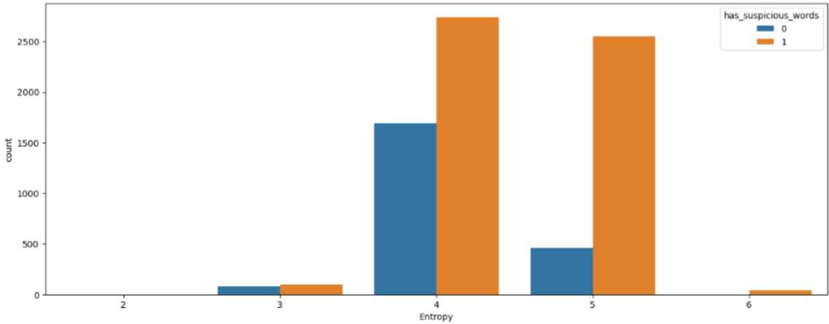
Suspicious-Entropy
Based on the cross-correlation, we checked the following graphs

Slide 8
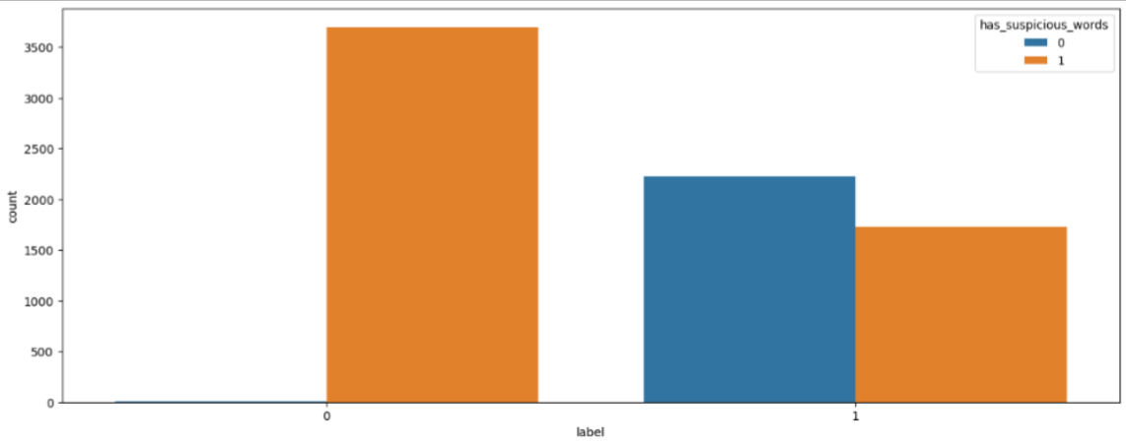
Suspicious-Label

Slide 9
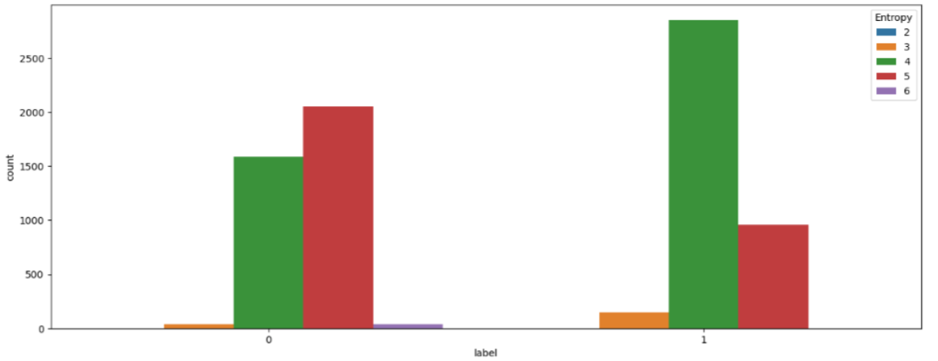
Label-Entropy

Slide 10

Training (Models)
XGBClassifier
RandomForestClassifier
As part of the evaluation, we used fivefold Cross-Validation with both models and got the highest score with the XGBoost.

Slide 11
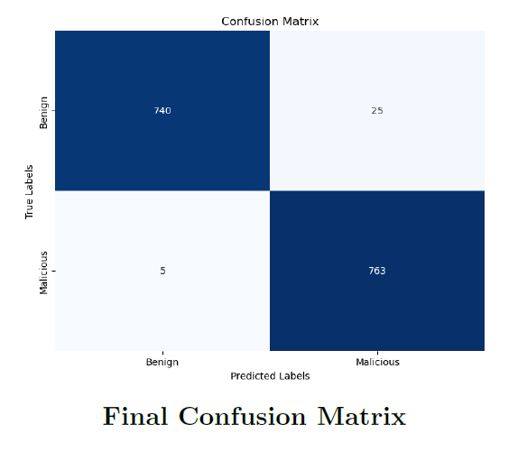
Confusion Matrix of the Final Model

Slide 12
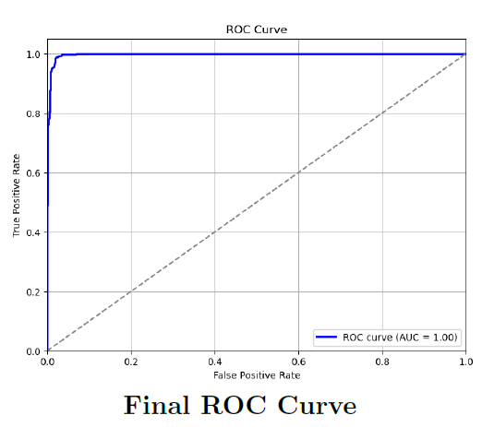
ROC Curve of the Final Model
The Receiver Operating Characteristic (ROC) curve was employed to illustrate the trade-off between true positive rate (sensitivity) and false positive rate (1 - specificity) across different threshold values.

Slide 13

Strongest Model -
five-fold cross-validation with the XGBoost (Extreme Gradient Boosting) model
In our experiments, the five-fold cross-validation achieved an accuracy of 98.66%, surpassing the paper’s reported accuracy of 97.76%.

Slide 14
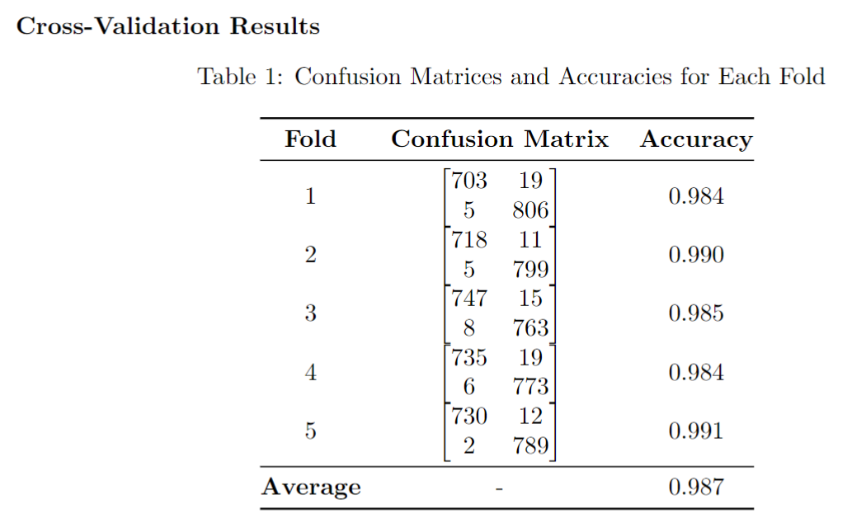
Strongest Model -

Slide 15
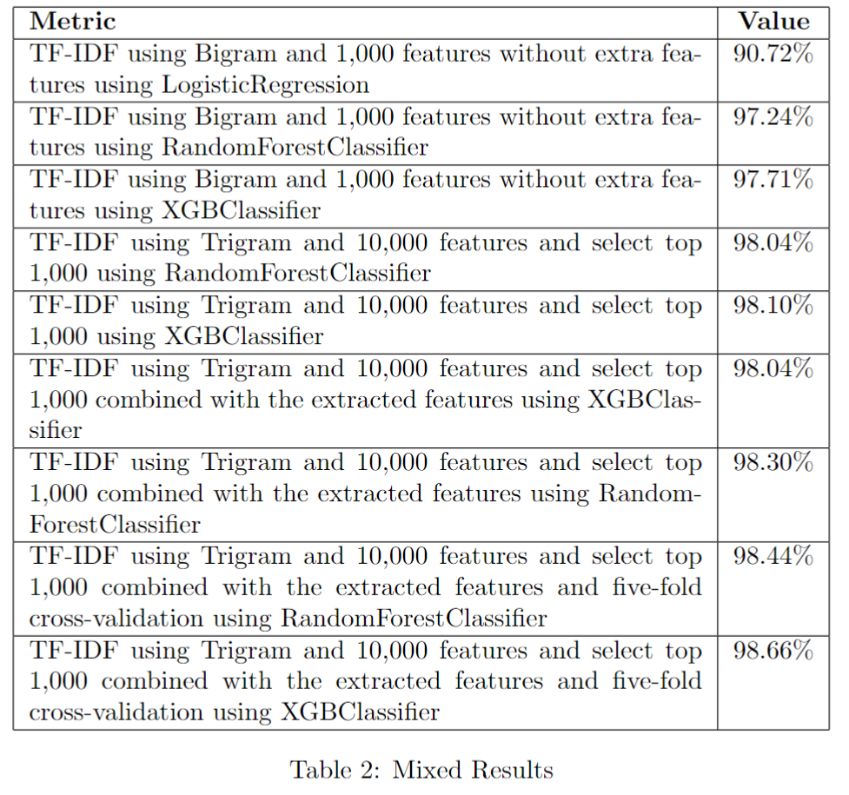
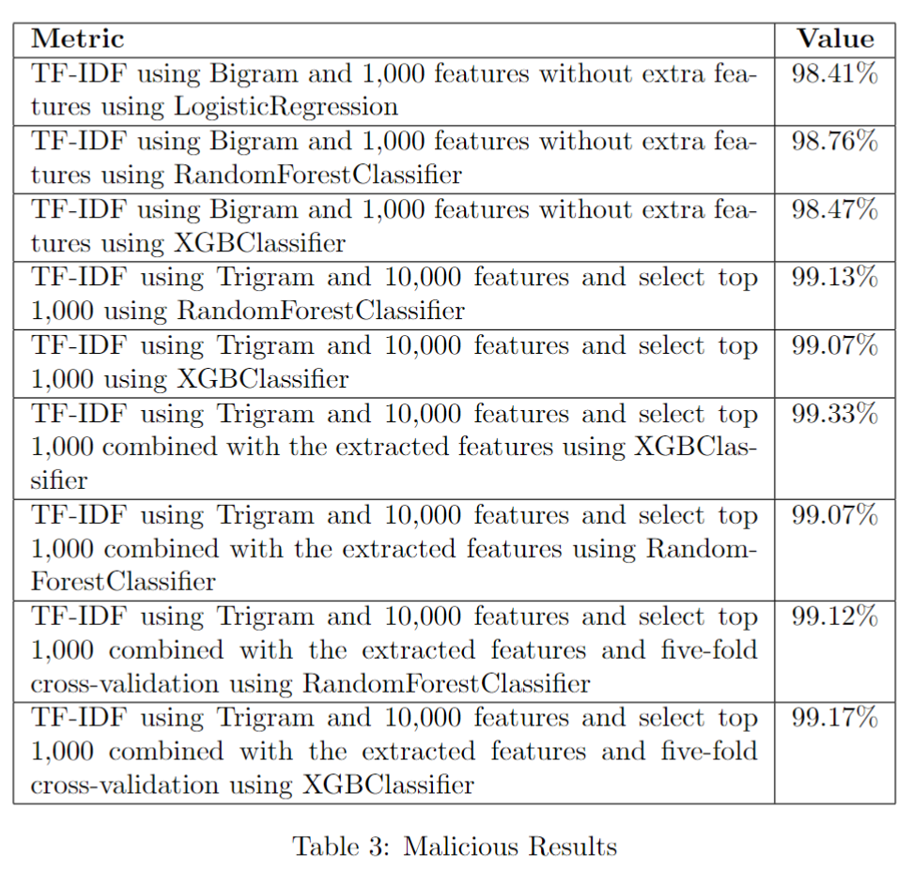
Reducing Mistakes Process

Slide 16
Choosing the final model
As our final step, we evaluated the top-performing models on the second dataset. Specifically, we tested the model trained on the malicious dataset with the mixed data and vice versa. Remarkably, the model trained on the mixed data demonstrated significantly superior performance, achieving an accuracy of 97.28\%. In contrast, the model trained on the malicious data and tested on the mixed data yielded an accuracy of 35\%. Therefore, we opted to showcase the model trained on the mixed data due to its stronger performance.

Slide 17
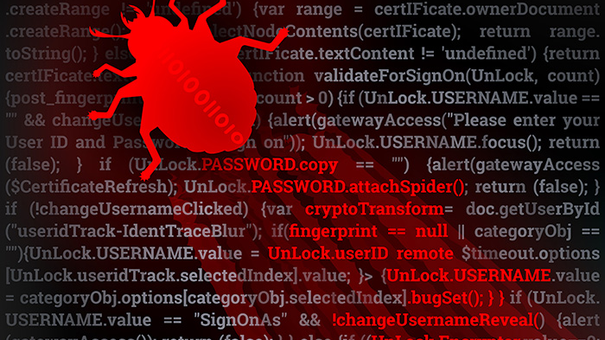
Demo

Slide 18

Future Work
De-obfuscate the obfuscated scripts – for better analyzing.
Create malicious scripts and remove duplicates.
Try to classify using neuro-networks and deep learning

Slide 19

References
Our github: https://github.com/TaliaSeada/UI_cyber/tree/master/model
https://doi.org/10.1016/j.neucom.2021.03.117
https://www.sciencedirect.com/science/article/pii/S0925231221005099
https://www.microsoft.com/en-us/security/blog/2019/09/03/deep-learning-rises-new-methods-for-detecting-malicious-powershell/
https://posts.specterops.io/learning-machine-learning-part-1-introduction-and-revoke-obfuscation-c73033184f0
https://github.com/GhostPack/Invoke-Evasion/tree/main
https://github.com/PowerShellMafia/PowerSploit

